Slide 1



SELF SERVICE VIZ TOOL
Capstone Project by Kurt Amodia
October 2025

Slide 2


DATA
Notes:
With the rise of technology, data has become more important than ever. From smartphones and social media, to systems and AI, data is at the core of how systems operate.

Slide 3
DATA
Data-driven decision-making = critical in companies
Notes:
And with that, companies use this data to drive their decision making, to fuel innovation, and to offer valuable insights for their company. In today's world, the ability to collect, analyze, and interpret this data has become a necessity.

Slide 4
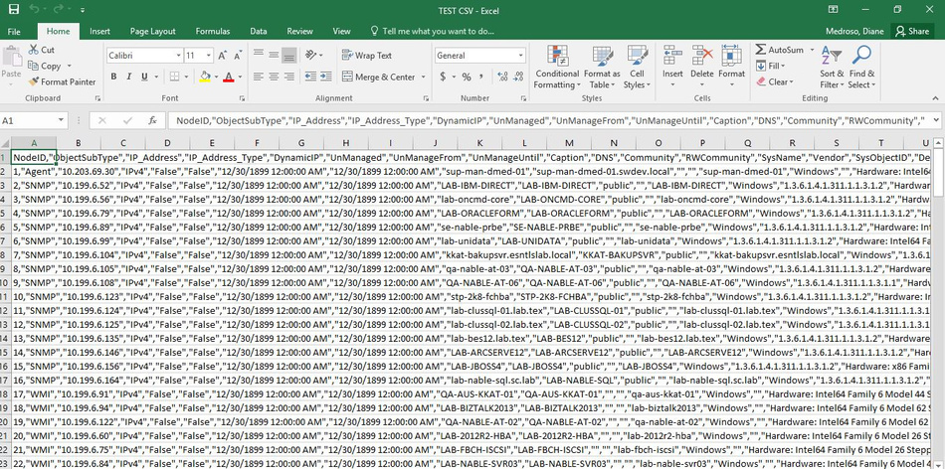
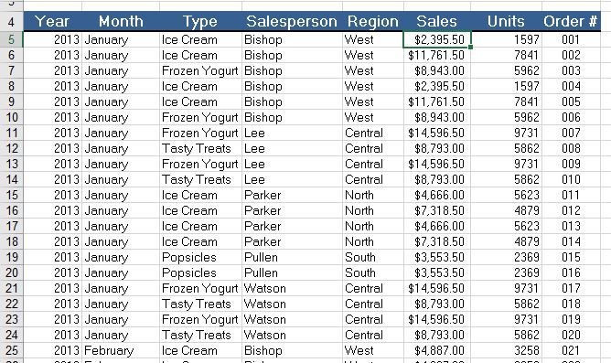
Notes:
But this is how data usually looks like in its purest form. A bunch of numbers and text. And so when management wants insights, they don't really want to look at this.

Slide 5

Visualizations!
Notes:
And so that's why companies make use of visualizations. Charts and graphs that make this numbers look more consumable. From rows of data, its aggregated into simple charts that looks good for management.

Slide 6
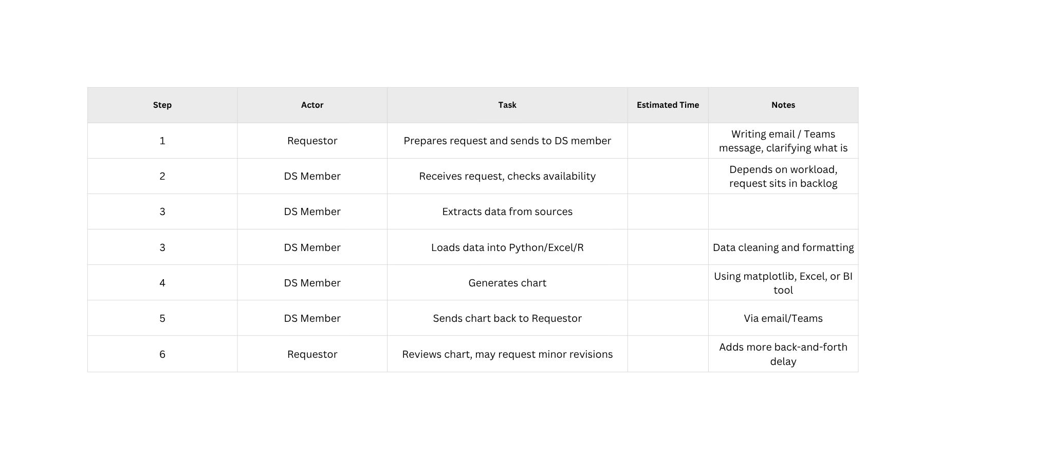
WORKFLOW
VizLy | 2025
Notes:
For most companies, the workflow usually looks like this:

Slide 7
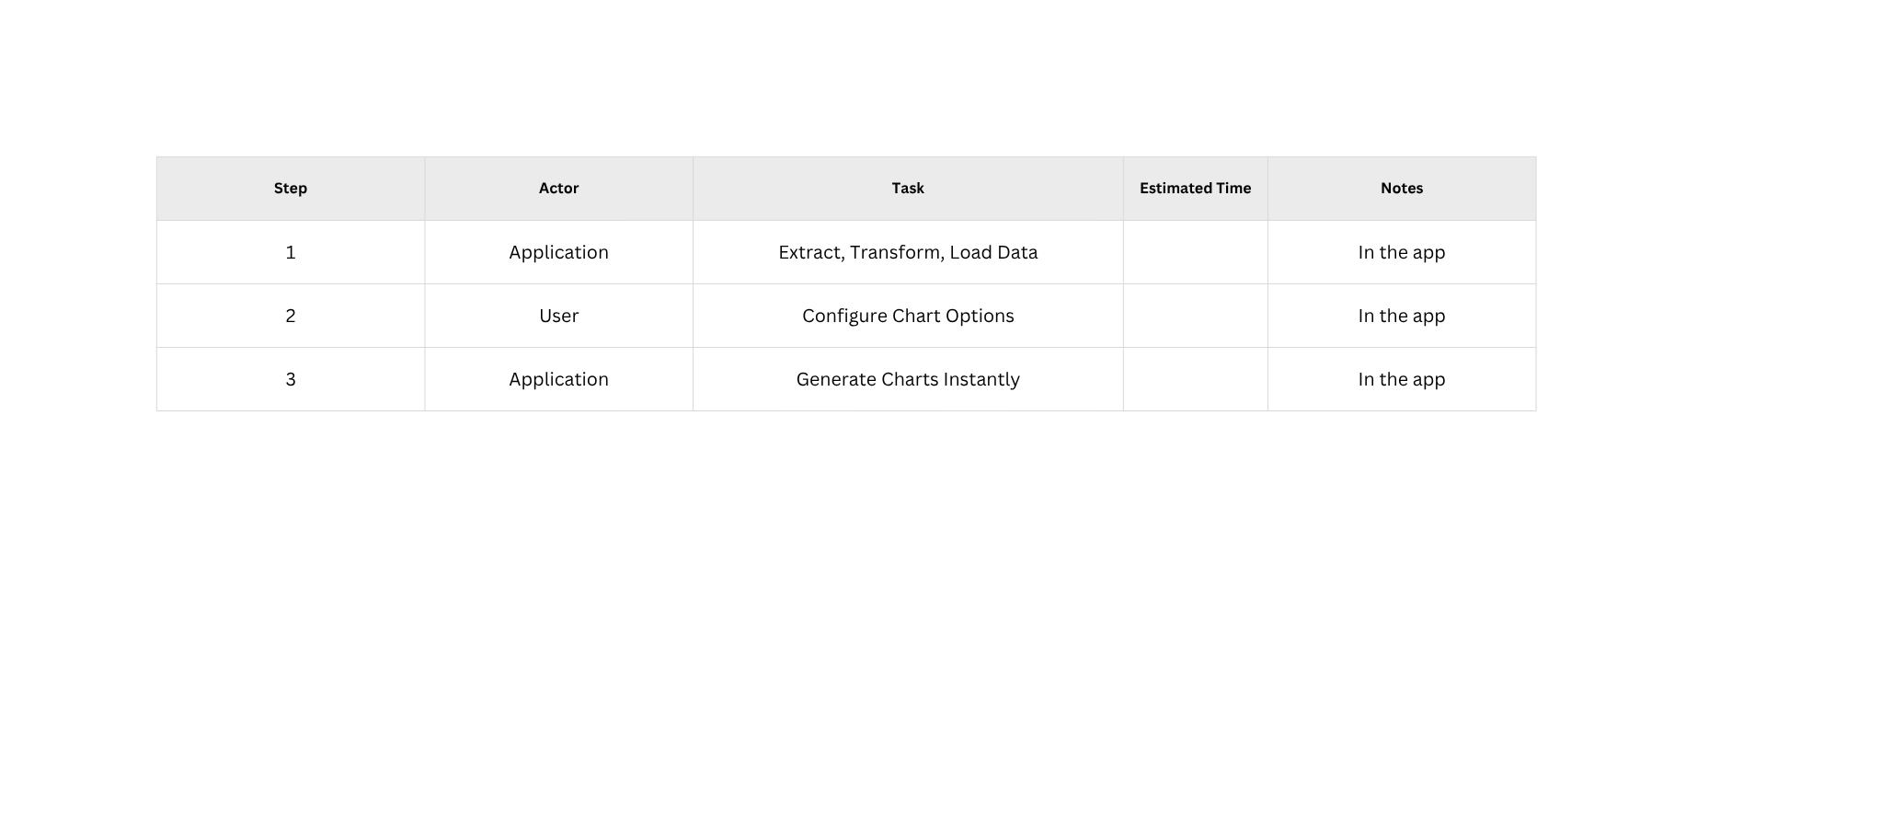
APPLICATION WORKFLOW
VizLy | 2025
Notes:
What we want is to make this workflow lose some steps. So we want to move some of these workflows to the application, to the machine.

Slide 8
OBJECTIVES
1
Handle data from sources and process the data
2
Create customized charts and dashboards for real time updates
3
Benchmark charting libraries for projects that might use the same tools
Notes:
So this is what we are aiming for.

Slide 9
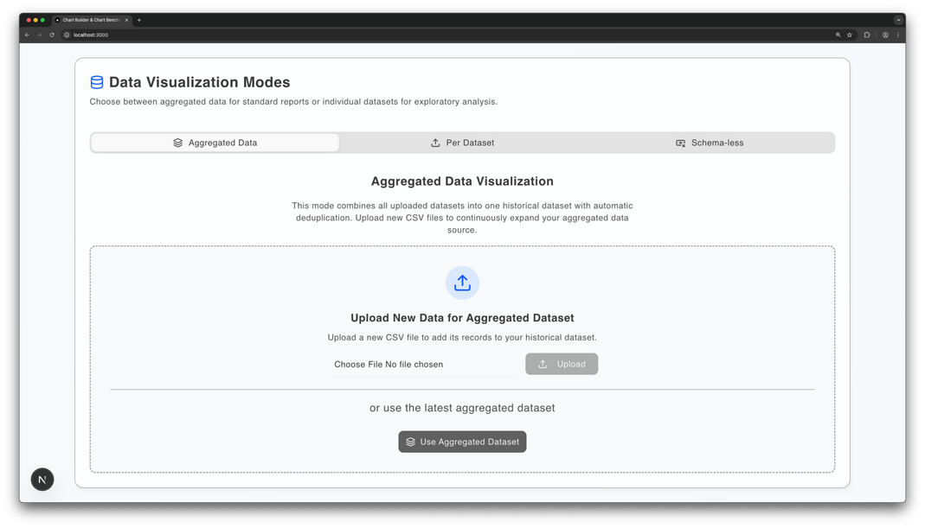
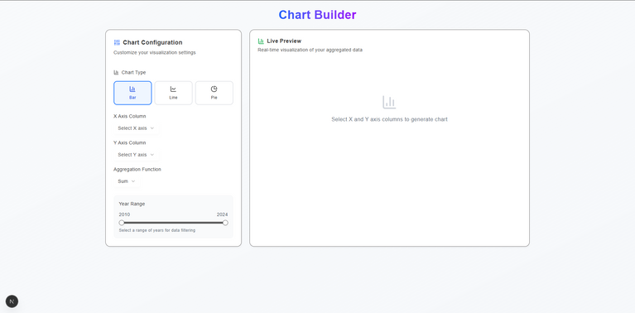
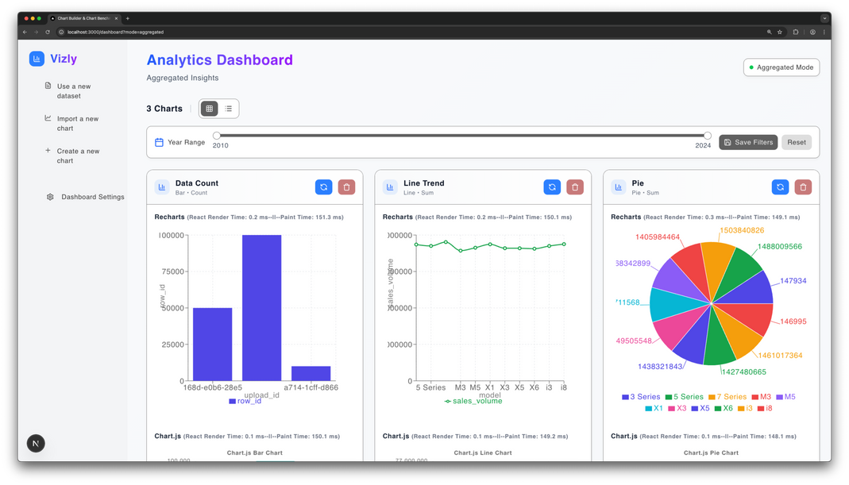
KEY FEATURES
Data Processing
Chart Building and Performance Tracking
Real Time Dashboard
VizLy | 2025

Slide 10
DEMO
VizLy | 2025

Slide 11
INSIGHTS / BENCHMARK
VizLy | 2025

Slide 12
EASE OF USE
Recharts
Charts.js
Plotly
Most beginner-friendly and React-native
Lightweight and easy to learn with strong community support
Feature-rich but heavier and more complex
VizLy | 2025

Slide 13
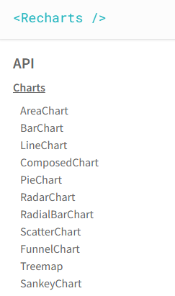
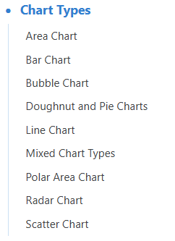
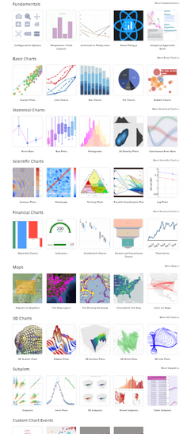
EXTENSIVENESS
Recharts
Charts.js
Plotly
Source: https://recharts.github.io/en-US/api
Source: https://www.chartjs.org/docs/latest/
Source: https://plotly.com/javascript/
VizLy | 2025

Slide 14
RENDERING / BUNDLE SIZE
Recharts
Charts.js
Plotly
Moderate performance with efficient SVG rendering
Minimal bundle size and optimized Canvas rendering.
Powerful WebGL features but slower initial load times.
VizLy | 2025
Notes:
The problem with recharts is that it because it uses SVG elements to render, it treats every individual visual element as a separate SVG. So it adds to the DOM Tree, which in cases like we have data points of up to 10000, and we want to display each point, each point is an svg element which is then added to the DOM Tree and very CPU intensive, so the computer may lag or freeze.
For Plotly, it uses the webGL for its rendering because its better for complex graphics by utilizing the GPU. But it has a larger bundle size since in involves a more complex setup to manage the state and communicate with the GPU.

Slide 15
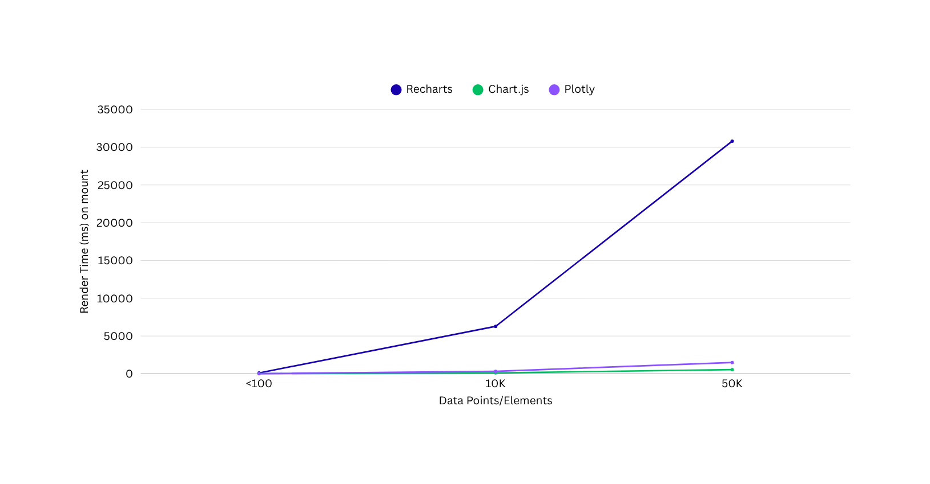
PERFORMANCE METRICS
CHART (20 ITERATIONS AVERAGED FOR <100 ; 5 ITERATIONS FOR OTHERS)
VizLy | 2025

Slide 16
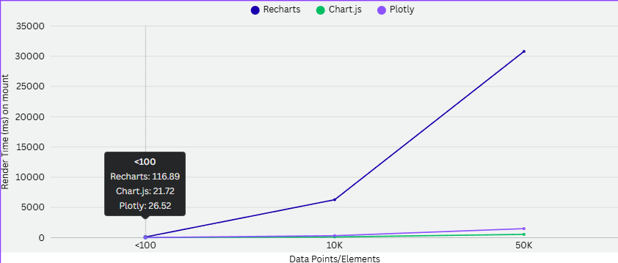
PERFORMANCE METRICS
CHART (20 ITERATIONS AVERAGED)
VizLy | 2025

Slide 17
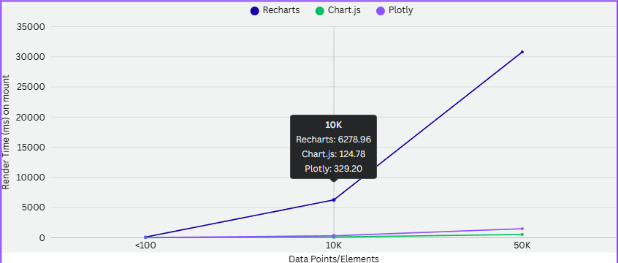
PERFORMANCE METRICS
CHART (20 ITERATIONS AVERAGED)
VizLy | 2025

Slide 18
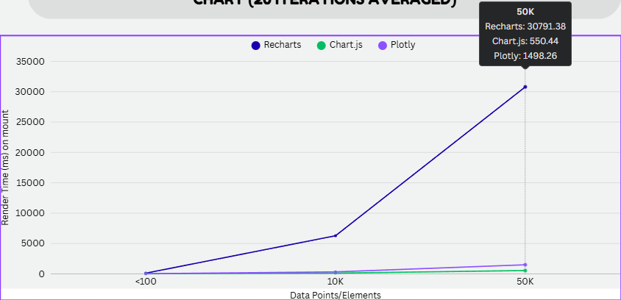
PERFORMANCE METRICS
CHART (20 ITERATIONS AVERAGED)
VizLy | 2025

Slide 19
CONCLUSION
If focus = simplicity and React-integration → Recharts
If focus = speed and minimal footprint → Chart.js
If focus = advanced analytics and interactivity → Plotly.js
VizLy | 2025

Slide 20
THANK YOU
Presentation by Kurt Amodia
VizLy | 2025

